Slide 1

SCD vs MCD
Notes:
Here to talk on Stablecoins and Makerdao

Slide 2

Agenda
ELI20
Statistics
Who is running this thing
SCD -> MCD differences
Managing the migration
Roadmap and longer term goals

Slide 3

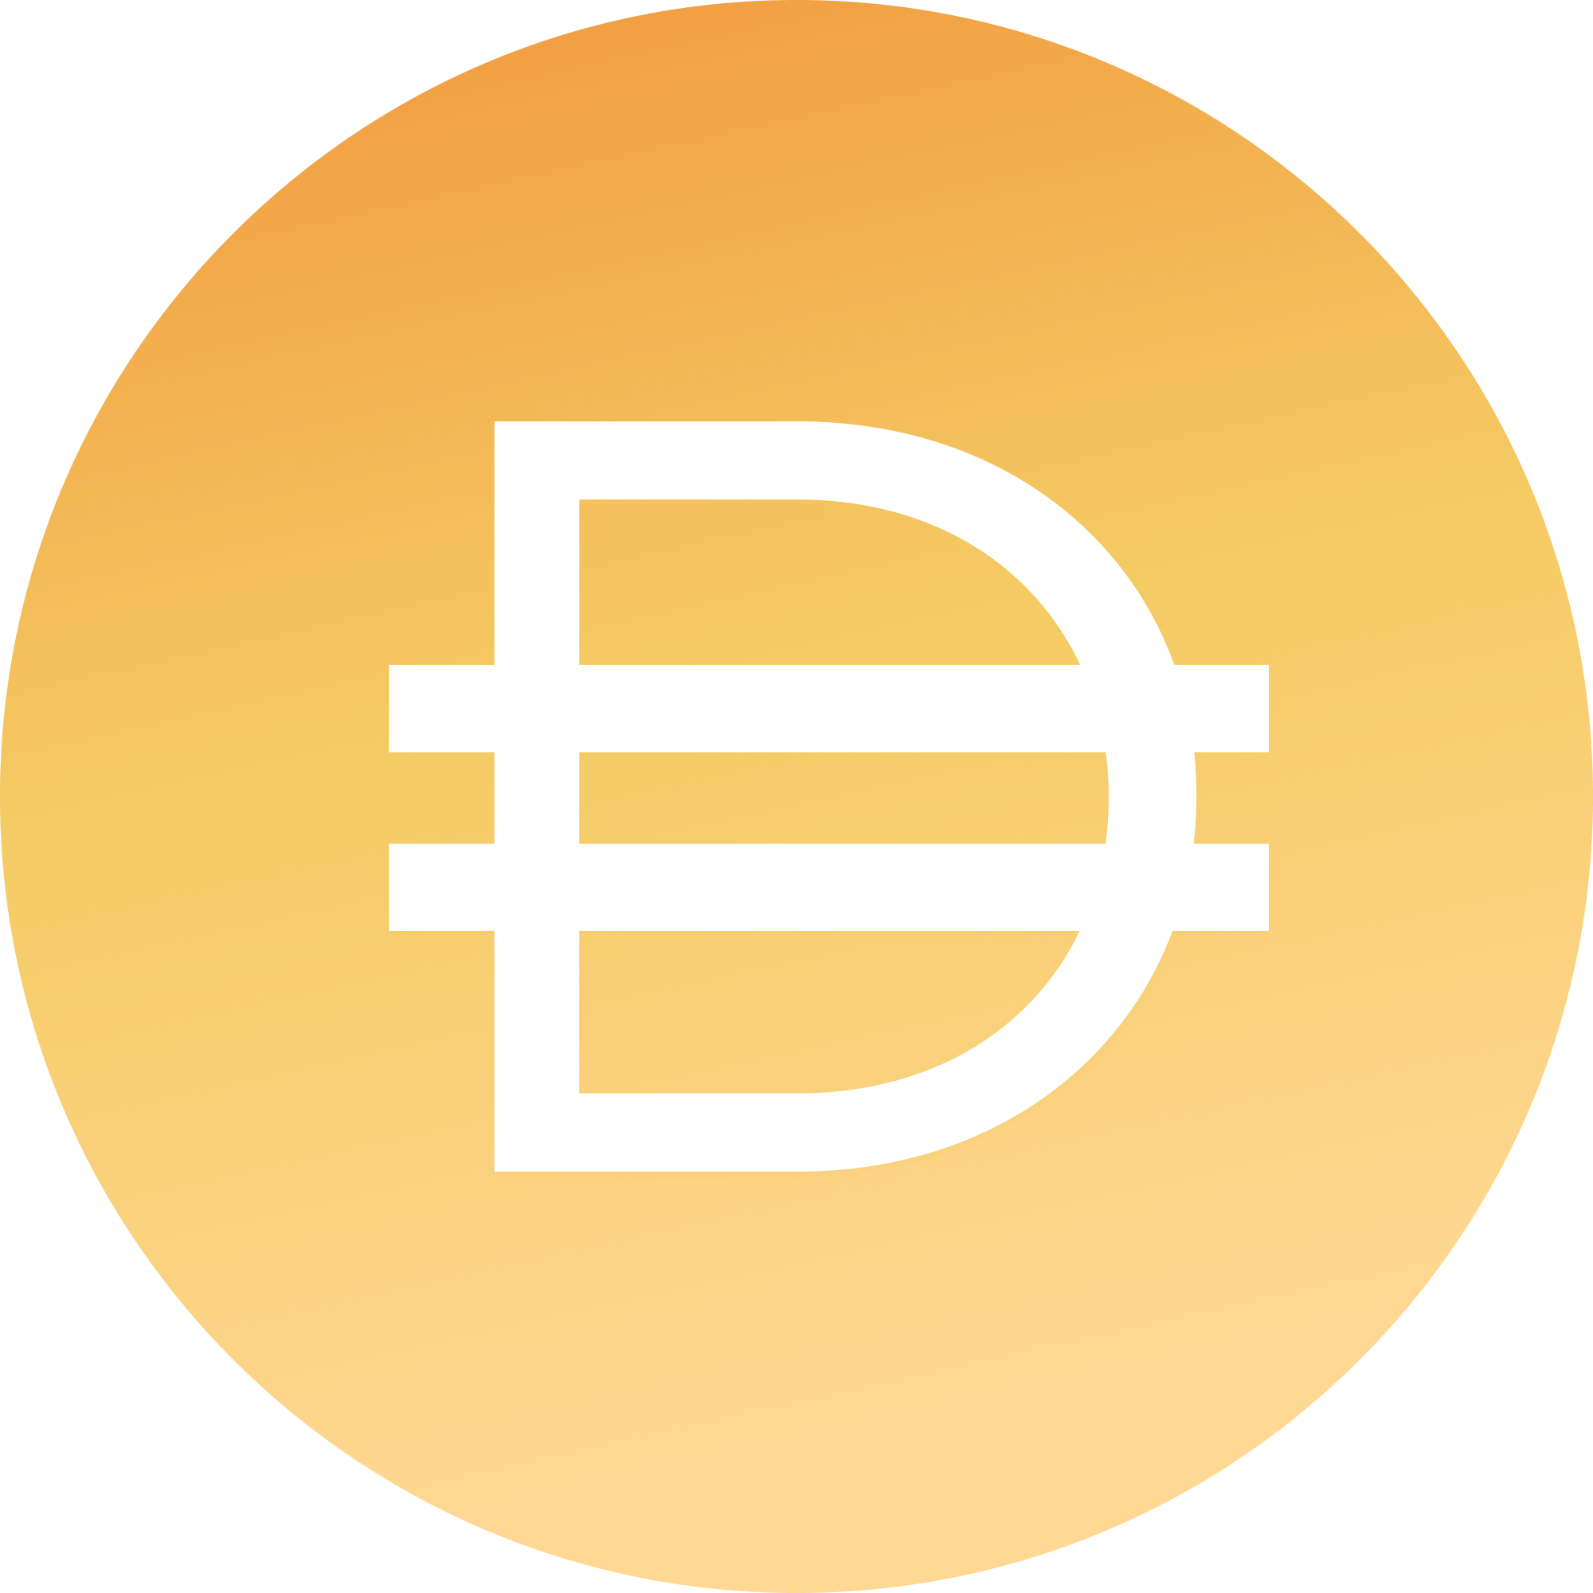
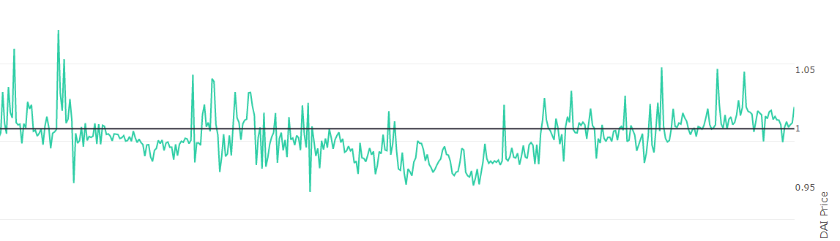
Dai Stablecoin
Dai
created through CDPs
backed by collateral
censorship resistant
pegged to the US Dollar
Notes:
An attempt to create a stablecoin that has everything necessary to unlock the potential of blockchain.
Crypto asset ment for the end user
Crypto collateralized stablecoin
Stability is backed by a decentralized platform, and on this decentralized platform there are different types of collateral (ethereum, tokenized asset, such as digix gold), they are combined into a portfolio of assets that together back the stability of dai.

Slide 4

Dai Stablecoin
Lending
NFT markets
Lossless lotteries
Exchange pairs
Remittances
Payments & online purchases
Philanthropy
Hedging
Prediction Markets
Notes:
Any financial service or product can be imagined with the use of Dai

Slide 5
Maker’s Stablecoin
Any economic activity
Notes:
Any financial service or product can be imagined with the use of Dai

Slide 6
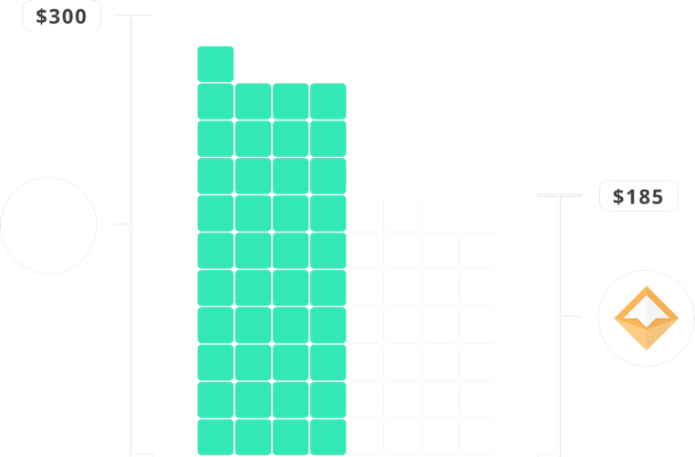
Vault(formerly CDP)
$
Notes:
The second and third reasons one would interact with the Dai Credit System is via what we call a Collateralized Debt Position, or CDP for short. Both of these use cases are speculative and are dependent on the creator having faith in the future value increase of the asset they are depositing into the CDP.
Overcollateralization ensures that in event of a rapid decrease in asset price that a CDP can be liquidated with extra value to spare. This ensures that Dai holders can sleep well at night knowing that no matter what happens to the price of the asset backing their Dai that they can always receive equivalent value of the assets backing the Dai in circulation.
At the time of writing CDP’s were currently 370% over-collateralized.

Slide 7

Vault(formerly CDP)
Notes:
The second and third reasons one would interact with the Dai Credit System is via what we call a Collateralized Debt Position, or CDP for short. Both of these use cases are speculative and are dependent on the creator having faith in the future value increase of the asset they are depositing into the CDP.
Overcollateralization ensures that in event of a rapid decrease in asset price that a CDP can be liquidated with extra value to spare. This ensures that Dai holders can sleep well at night knowing that no matter what happens to the price of the asset backing their Dai that they can always receive equivalent value of the assets backing the Dai in circulation.
At the time of writing CDP’s were currently 370% over-collateralized.

Slide 8
SCD Recent Snapshot
as of 7:00pm 11/17/2019: Current Stability Fee 5%
Total Dai Supply ⬙101,699,644 Total Collateral Value $347,486,518.23
Collateralization Ratio 341.681%
ETH Locked 1,879,575.487
2500 CDPs with x>100 Dai generated
6000+ CDPs with x>1 Dai generated
https://saistats.com/
http://dai.descipher.io/
http://loans.descipher.io/
http://makerdao.descipher.io/
https://graphs.santiment.net/makerdao
https://mkr.tools/
Notes:
Explain each colored chart

Slide 9
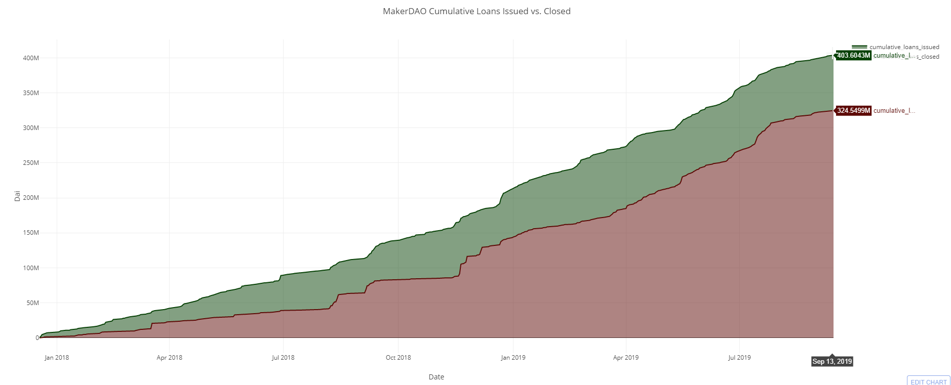
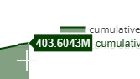
SCD Launched 12/18/2017, 700 days ago
Loans originated in less than 2 years 09/17/2019 date of graph
Notes:
Explain each colored chart

Slide 10
???????????????????????????????????????????????????????????????????????????????????????????????????????????????????????????????????????????????????????????????????????????????????????????????????????????????????????????????????????????????????????????????????????????????????????????????????????????????????????????????????????????????????????????????????????????????????????????????????????????????????????????????????????????????????????????????????????????????????????????????????????????????????????????????????????????????????????????????????????????????????????????????????????????????????????????????????????????????????????????????????????????????????????????????????????????????????????????????????????????????????????????????????????????????????????????????????????????????????????????????????????????????????????????????????????????????????????????????????????????????????????????????????????????????????????????????????????????????????????????????????????????????????????????????????????????????????????????????????????????????????????????????????????????????????????????????????????????????????????????????????????????????????????????????????????????????????????????????????????????????????????????????????????????????????????????????????????????????????????????????????????????????????????????????????????????????????????????????????????????????????????????????????????????????????????????????????????????????????????????????????????????????????????????????????????????????????????????????????????????????????????????????????????????????????????????????????????????????????????????????????????????????????????????????????????????????????????????????????????????????????????????????????????????????????????????????????????????????????????????????????????????????????????????????????????????????????????????????????????????????????????????????????????????????????????????????????????????????????????????????????????????????????????????????????????????????????????????????????????????????????????????????????????????????????????????????????????????????????????????????????????????????????????????????????????????????????????????????????????????????????????????????????????????????????????????????????????????????????????????????????????????????????????
Notes:
Makerdao
Started before the ethereum project was launched and set out to create the best stable coin
May be worth mentioning:
A stable coin needs key features
Decentralized
Fundamental stability that has been proven -> real assets and real value that backs the stable coin

Slide 11
Maker’s Governance Token
MKR
Governance Token
1,000,000 in existence
MKR holders make decisions about the Maker protocol through on-chain governance
https://vote.makerdao.com/
Notes:
Governance token that controls the platform that backs the dai stable coin
For the advanced user that wants to get into the advanced governance of a decentralized financial platform
Maker holders make the crucial decisions on what collaterals to allow into the system and on what terms.
E.g. ethereum should be more risky than tokenized gold, which is more risky than tokenized bonds
MKR is used for voting in new collateral types and it is also used to vote on the risk parameters associated with these collateral types.
It is also a necessary ingredient to close a CDP and is thus the fuel for the Dai Credit System

Slide 12
Notes:
The current version of Dai in the wild is single collateral which means that if a black swan were to occur and the price of ETH was to drop instantaneously across all exchanges at once to 0, then Dai would fail. The multi collateral version of Dai is due to be released in June will be resilient even in the face of such an event because the collateral pool will be diversified with non-correlated assets. This means that even if one collateral type fails completely that Dai holders would still be made whole because all CDPs in which the Dai were created are all over-collateralized.

Slide 13
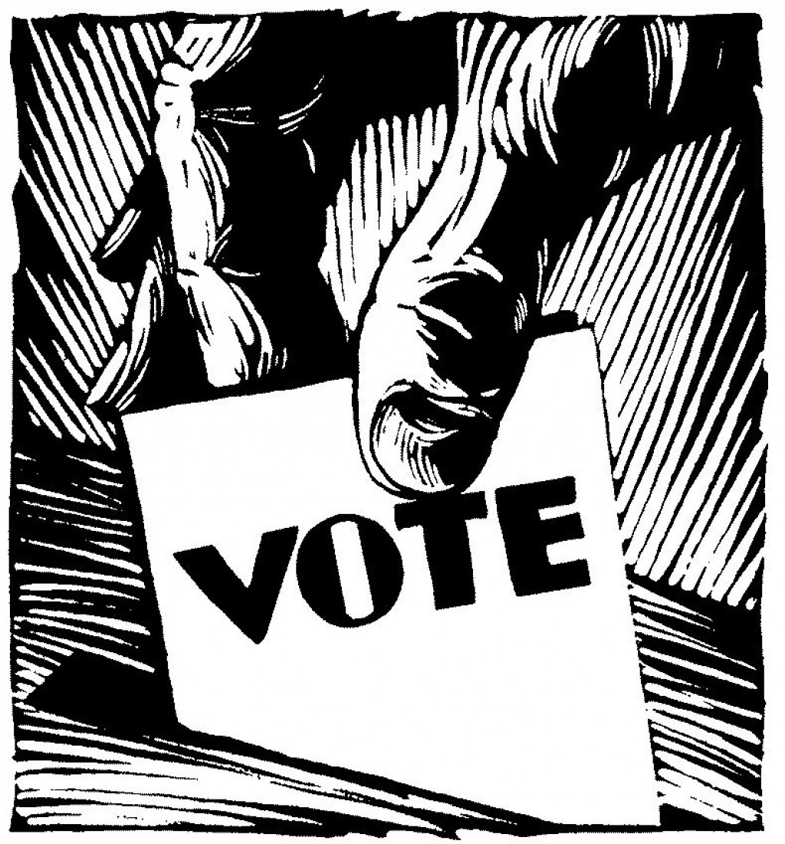
What have MKR Voters done in governance so far?
as of 11/17/2019
Ratified the Foundation Proposal
Raised the debt ceiling once from 50MM to 100MM
21 Stability Fee adjustments
Established the first Asset Priority List
Ratified the Risk Team mandate
Ratified the Governance Facilitator Role
Changed SF polls to have exponential rate-stepping options
Ratified the Oracle Team mandate
Ratified the Oracles Incentives Restructuring proposal
Ratified the Responsible Oracle Migration Proposal
Ratified the DeFi Public Feed Proposal
Ratified the Migration Proposal and Executive vote
Notes:
Explain each colored chart

Slide 14
What have MKR Voters done in governance so far?
30+ Governance Polls
21+ Executive Votes
Notes:
Explain each colored chart

Slide 15
How?
as of 11/17/2019
10/01/2019
Most discussions happen on the forum (forum.makerdao.com)
Last 30 days: 402 posts, 34 Topics, 179 active users
Weekly Governance and Risk calls
summarized
transcribed
audio recording
video recording
Rich acting as a governance facilitator
helps surface important topics & blockers
executes on the needs of governance
Foundation Team facilitates each poll and vote
constructs the code for the proposal itself
host all relevant information on the voting dashboard
Notes:
The current version of Dai in the wild is single collateral which means that if a black swan were to occur and the price of ETH was to drop instantaneously across all exchanges at once to 0, then Dai would fail. The multi collateral version of Dai is due to be released in June will be resilient even in the face of such an event because the collateral pool will be diversified with non-correlated assets. This means that even if one collateral type fails completely that Dai holders would still be made whole because all CDPs in which the Dai were created are all over-collateralized.

Slide 16
Agenda
ELI5
Overall Statistics
Road to decentralized governance
SCD -> MCD
Managing the migration
Roadmap and longer term goals

Slide 17

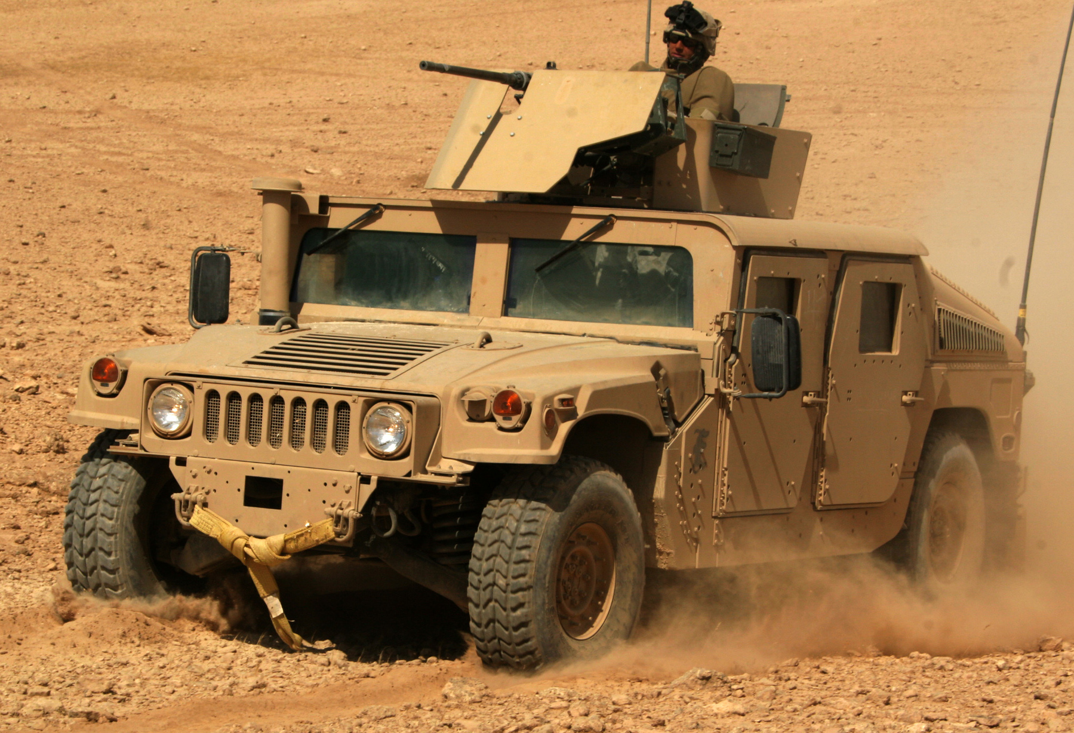
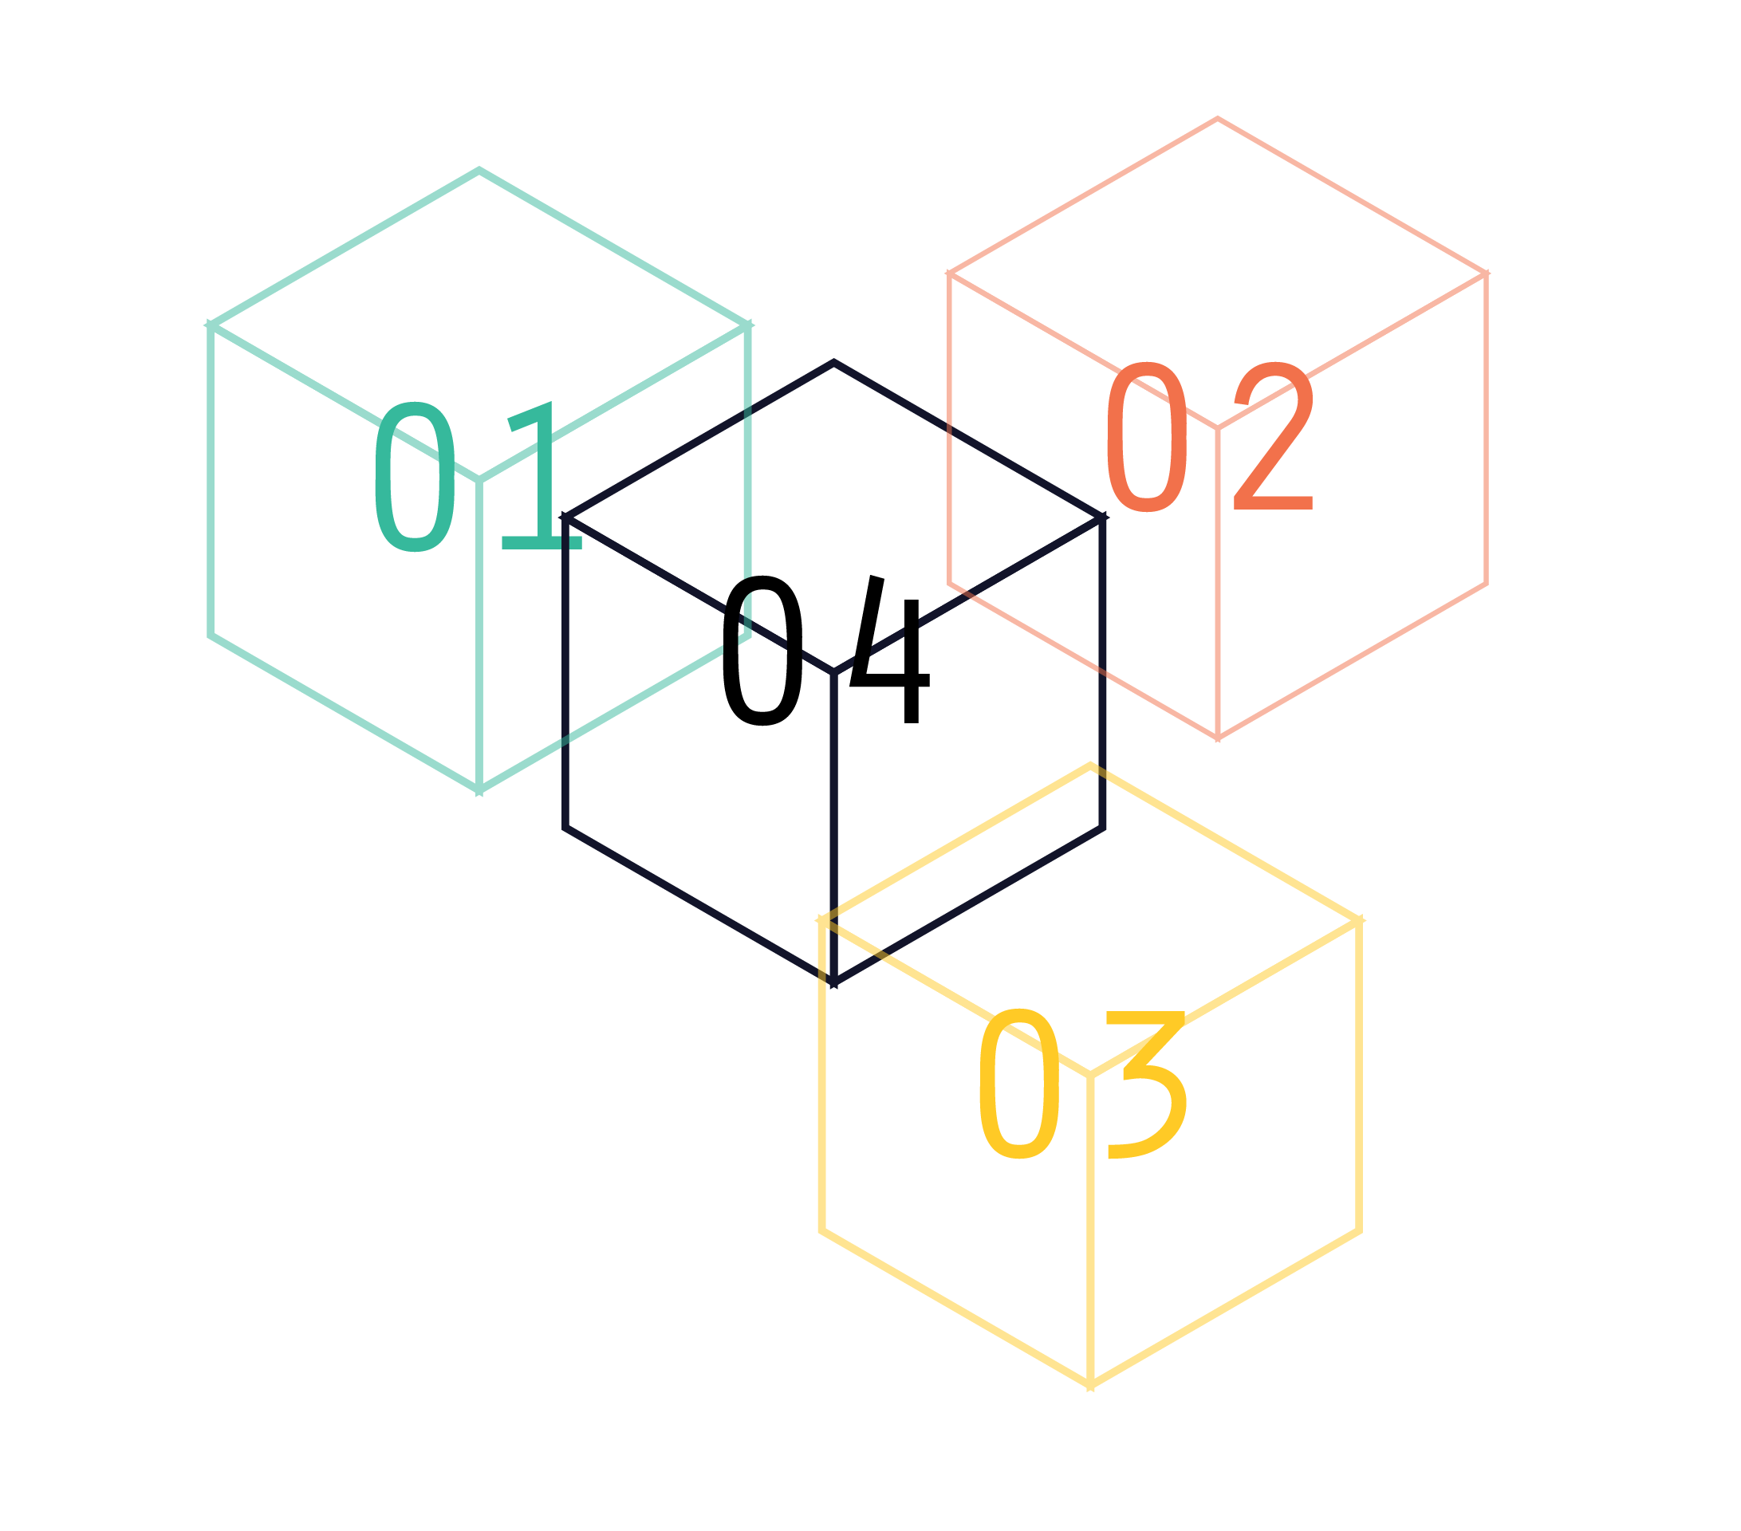
Properties of a durable stablecoin
(SCD)
Multi-collateral:
Resilience in the face of black swans.
Notes:
The current version of Dai in the wild is single collateral which means that if a black swan were to occur and the price of ETH was to drop instantaneously across all exchanges at once to 0, then Dai would fail. The multi collateral version of Dai is due to be released in June will be resilient even in the face of such an event because the collateral pool will be diversified with non-correlated assets. This means that even if one collateral type fails completely that Dai holders would still be made whole because all CDPs in which the Dai were created are all over-collateralized.

Slide 18
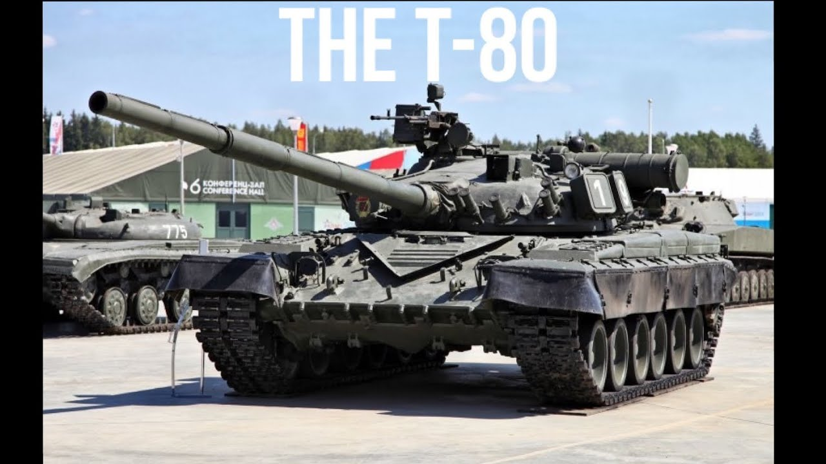
Properties of a durable stablecoin
(MCD)
Multi-collateral:
Resilience in the face of black swans.
Notes:
The current version of Dai in the wild is single collateral which means that if a black swan were to occur and the price of ETH was to drop instantaneously across all exchanges at once to 0, then Dai would fail. The multi collateral version of Dai is due to be released in June will be resilient even in the face of such an event because the collateral pool will be diversified with non-correlated assets. This means that even if one collateral type fails completely that Dai holders would still be made whole because all CDPs in which the Dai were created are all over-collateralized.

Slide 19
What are the functional differences?
Ability to add additional collateral types and Vault types
Liquidations occur through Auctions instead of fixed discount collateral sales
No more PETH
Liquidation penalty burns MKR instead of PETH
Dai is used to pay the Stability Fee
MKR minting as lender of last resort
Governance Security Module
Upgraded Oracles Infrastructure
Upgraded Emergency Shutdown Module
Core contracts formally verified
Notes:
The current version of Dai in the wild is single collateral which means that if a black swan were to occur and the price of ETH was to drop instantaneously across all exchanges at once to 0, then Dai would fail. The multi collateral version of Dai is due to be released in June will be resilient even in the face of such an event because the collateral pool will be diversified with non-correlated assets. This means that even if one collateral type fails completely that Dai holders would still be made whole because all CDPs in which the Dai were created are all over-collateralized.

Slide 20
What are some of the other changes?
SCD
Lack of solid documentation
cdp.makerdao.com
No DSR
Free Oracles
Individual Feeds
Parameters not based on real risk modeling
One Debt Ceiling
MCD
docs.makerdao.com
oasis.app/borrow
oasis.app/save
Oracles as a service
Individual + Organizational Feeds
REAL risk models:
proper collateral evaluation and parameter modeling
A Global Debt Ceiling + Debt Ceilings for each Vault type
Notes:
The current version of Dai in the wild is single collateral which means that if a black swan were to occur and the price of ETH was to drop instantaneously across all exchanges at once to 0, then Dai would fail. The multi collateral version of Dai is due to be released in June will be resilient even in the face of such an event because the collateral pool will be diversified with non-correlated assets. This means that even if one collateral type fails completely that Dai holders would still be made whole because all CDPs in which the Dai were created are all over-collateralized.

Slide 21
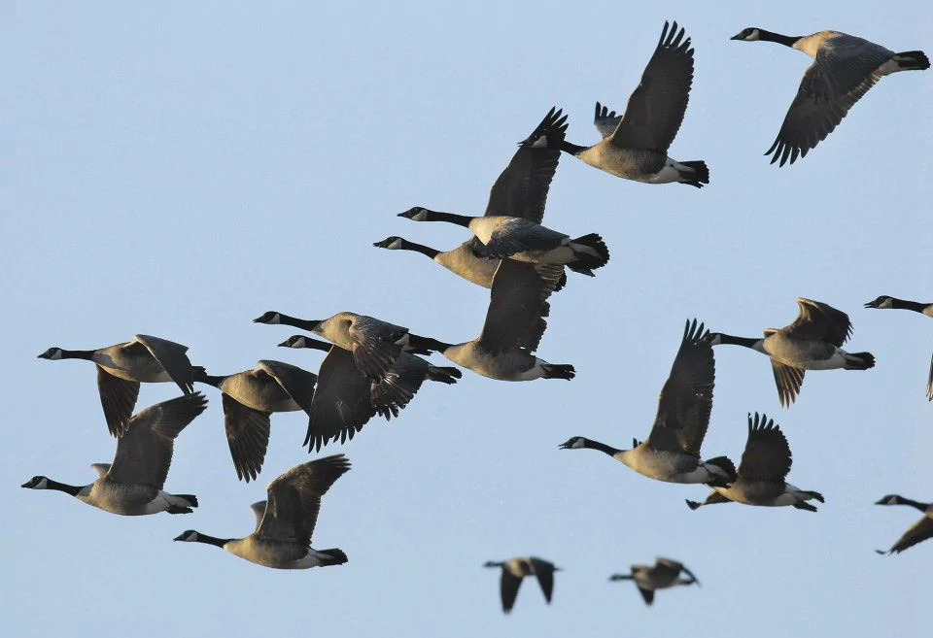
Migration?
Migration
Notes:
The current version of Dai in the wild is single collateral which means that if a black swan were to occur and the price of ETH was to drop instantaneously across all exchanges at once to 0, then Dai would fail. The multi collateral version of Dai is due to be released in June will be resilient even in the face of such an event because the collateral pool will be diversified with non-correlated assets. This means that even if one collateral type fails completely that Dai holders would still be made whole because all CDPs in which the Dai were created are all over-collateralized.

Slide 22

Migration
MKR token holders:
Pre-configured MCD with a ton of parameters
Auction parameters
Risk parameters
Module parameters
Govern two systems
through the same on-chain governance
Maintain pegs for two different types of Dai
Be prepared for emergency votes
MKR token holders (shown below)
Notes:
The current version of Dai in the wild is single collateral which means that if a black swan were to occur and the price of ETH was to drop instantaneously across all exchanges at once to 0, then Dai would fail. The multi collateral version of Dai is due to be released in June will be resilient even in the face of such an event because the collateral pool will be diversified with non-correlated assets. This means that even if one collateral type fails completely that Dai holders would still be made whole because all CDPs in which the Dai were created are all over-collateralized.

Slide 23

Migration
Dai holders use a tool that converts Sai into Dai
CDP owners use a tool that converts their sCDPs into mCDPs
Notes:
The current version of Dai in the wild is single collateral which means that if a black swan were to occur and the price of ETH was to drop instantaneously across all exchanges at once to 0, then Dai would fail. The multi collateral version of Dai is due to be released in June will be resilient even in the face of such an event because the collateral pool will be diversified with non-correlated assets. This means that even if one collateral type fails completely that Dai holders would still be made whole because all CDPs in which the Dai were created are all over-collateralized.

Slide 24
Where is the Maker Protocol heading?
MCD Launch: More collateral, more Dai, more liquidity
More sophisticated DAO participation & governance
more voting weight
delegation
MIPs
Relaunch of Oasis
Sustainable Oracles as a service, run by the Maker Protocol
Introduction of other synthetic assets
Fully Self-sustained and Decentralized
Notes:
The last method we use to ensure stability and security of the system is what we call global settlement.
At any point in time if the price of Dai strays too far away from the dollar... the system can be “globally settled”.
This means that the value of the assets which back each Dai can be made available to be redeemed by each Dai holder.
This THREAT ensures that a class of motivated actors called keepers can in good faith provide liquidity on either side of the peg and make a profit doing so as they know that if the price moves far enough away from the peg that the system can and will be settled.

Slide 25
Find out more and get involved!
chat.makerdao.com
forum.makerdao.com
awesome.makerdao.com

